Slide 1

Mental Health in College Student Populations Evidence from the national Healthy Minds Study
Sarah Ketchen Lipson, PhD EdM (she/her/hers)
Assistant Professor, Boston University School of Public Health
Co-Principal Investigator, the Healthy Minds Study
The UnLonely Symposium 2021, mini keynote #1
Mental Health & COVID-19: Urgency and Opportunity

Slide 2
Significance of population
Age of onset
Treatment delay
Prevalence and burden of disease ($)
Campus settings offer unique opportunity for prevention and intervention
Public health impact: >22 million students
Significance from developmental perspective
Human resources
Mental health and lifelong trajectory (economic, educational, social)
Notes:
How this relates to other populations -- AYAs

Slide 3
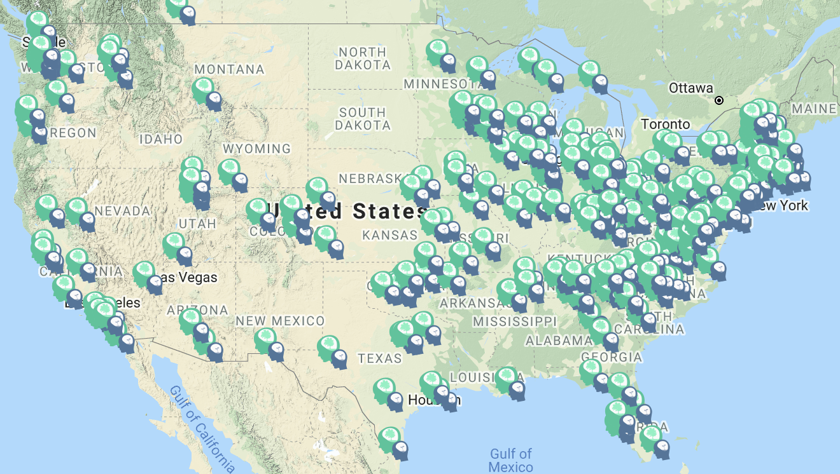
About the Healthy Minds Study
HMS team:
PIs: Sarah Lipson, Daniel Eisenberg, Justin Heinze
Peter Ceglarek, Paula Guro, Matt Jirsa, Afra Kamal, Divya Manikandan, Kevin Michaels, Jasmine Morigney, Akilah Patterson, Ellie Repp, Maithelee Sathe, Meghna Singh, Liadan Solomon, Amber Talaski, Caleb Wang, Adam Wheeler, Sasha Zhou
~400 campuses, >350,000 student respondents
Annual mental health survey
Cross-sectional
Qualtrics
Random student samples at each campus
Validated screening tools for mental health

Slide 4
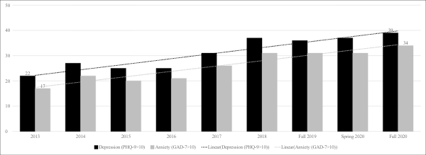

Rising prevalence of depression and anxiety symptoms, 2013-2020

Slide 5
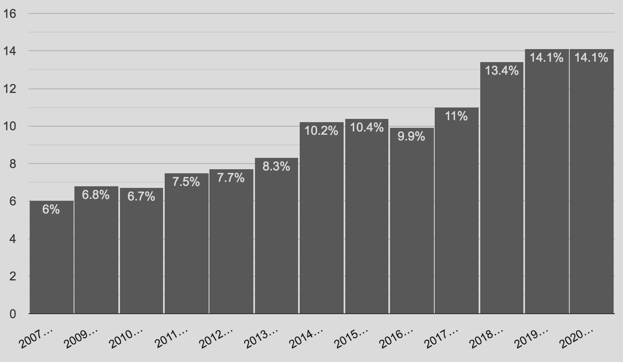
Suicidal ideation over time

Slide 6
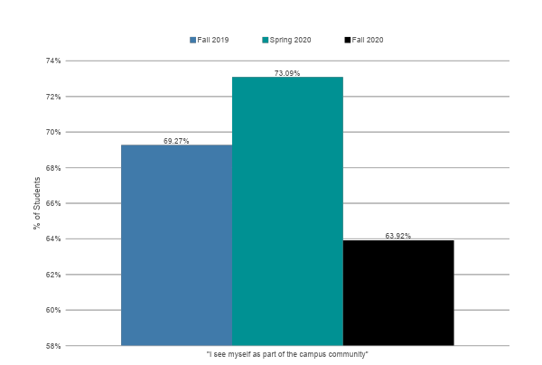
Sense of belonging

Slide 7
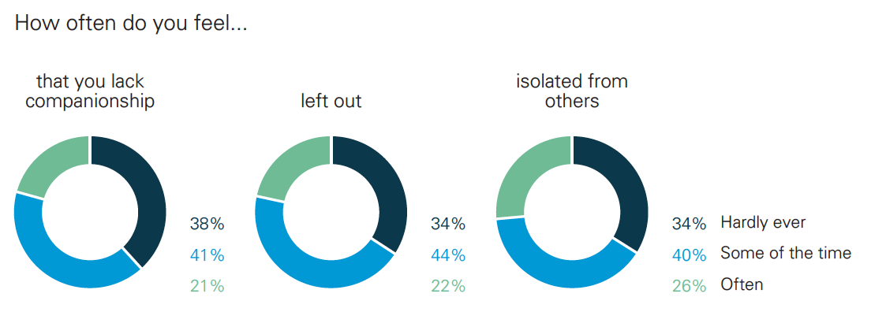
Loneliness, fall 2020

Slide 8
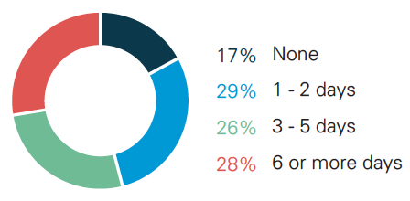
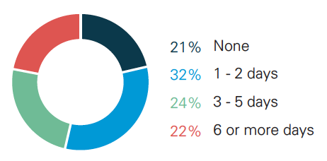
Academic impairment due to mental health concerns, past 4 weeks
Fall 2020
Fall 2019
83%
Reported at least 1 day of academic impairment due to MH
Increase
78%
Reported at least 1 day of academic impairment due to MH

Slide 9
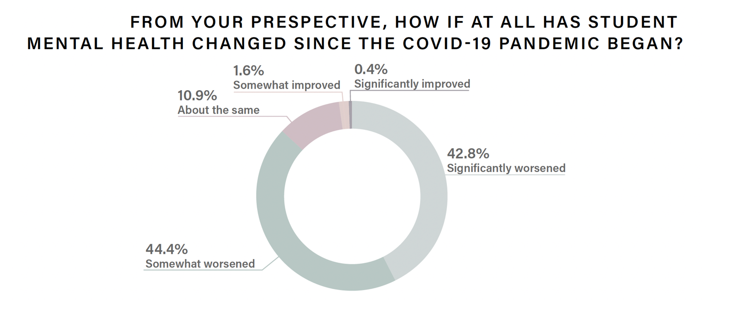
87% of faculty observe that student mental health has worsened in the pandemic
Notes:
Like reflects at least 2 things (actual worsening of student mental health and heightened awareness/exposure for faculty to see student mental health)

Slide 10
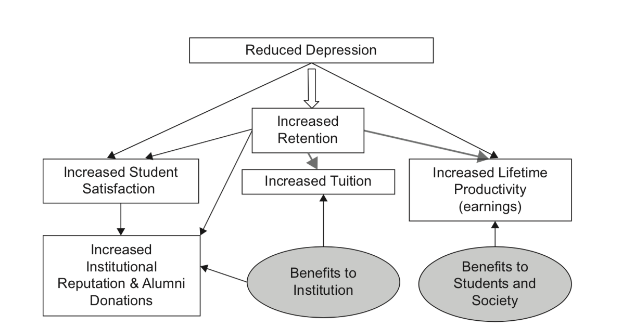
Economic case: strong return on investment for student mental health treatment & prevention
https://umich.qualtrics.com/jfe/form/SV_6xN9QUSlFtgtRQh

Slide 11

Thank you!
Sarah Ketchen Lipson, PhD EdM
sklipson@bu.edu
@DrSarahLipson
@healthymindsnet
www.healthymindsnetwork.org

