Slide 1

UnLonely Symposium
Mental Health & Covid: Urgency and Opportunity
The Foundation for Art & Healing Presents:

Slide 2
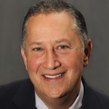

Welcome!
Jeremy Nobel, MD, MPH
Faculty, Center for Primary Care, Harvard Medical School; Harvard Chan School of Public Health
President, Foundation for Art & Healing; Founder of the UnLonely Project
Former Medical Director Verizon; NEBGH
Member, State of Maine’s Age Friendly Advisory Committee
Loves Poetry and Coffee

Slide 3
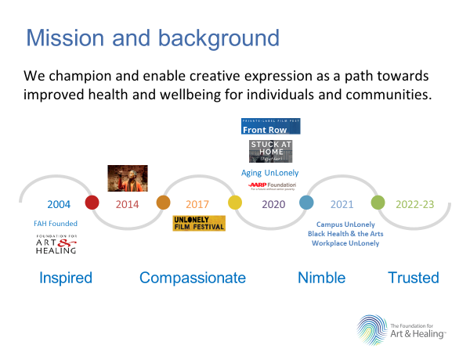

Slide 4

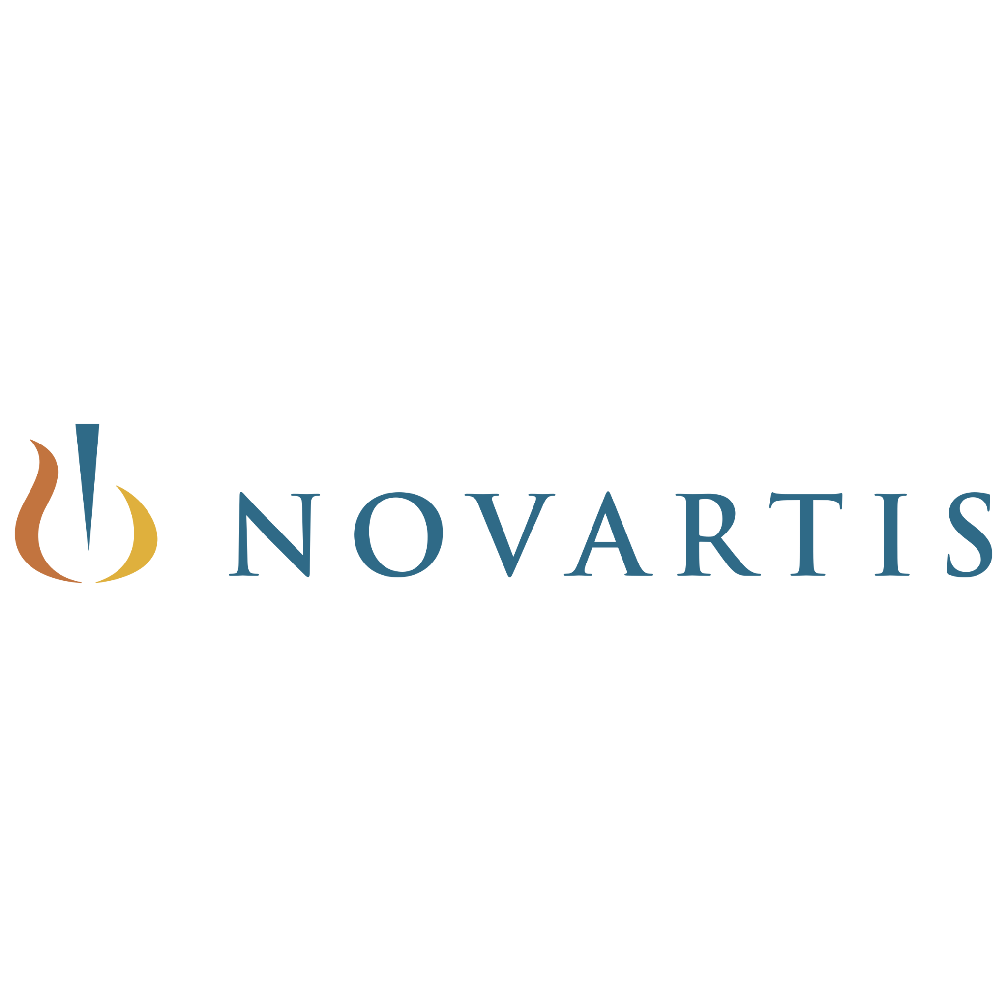






Thank You Sponsors!

Slide 5




Thank you to our Symposium
Promotional Partners!

Slide 6
Why the UnLonely Symposium
is Un-Usual
Examines loneliness and its burdens across populations, conditions and circumstances;
Strives to identify cross-cutting issues and challenges
Explores innovative cross-silo intervention opportunities; including use of the arts to engage, inspire and connect
Builds a professional community striving to address and mitigate loneliness and its burdens

Slide 7
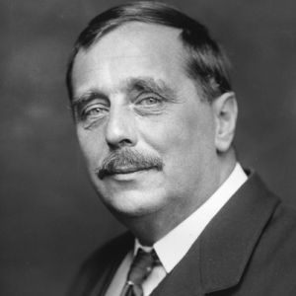
A Note of Urgency…
History is a race between
education and catastrophe.
- H.G. Wells

Slide 8
Educational Agenda
Intro: What are we trying to accomplish together today?
Keynoter Perspectives: Mental Health and the Pandemic
Sarah Lipson, PHD: Boston University; Health Minds
Doug Nemecek, MD: Cigna Behavioral Health
Mark Meridy: DOROT
Population Specific Breakouts
Synthesis and Discussion

Slide 9
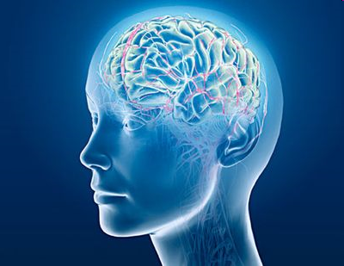
A powerful underlying principle: Creative arts rewires our brains
The arts stimulate thoughts, moods and feelings that change our brain, bodies and behaviors…
all impacting our health!

Slide 10
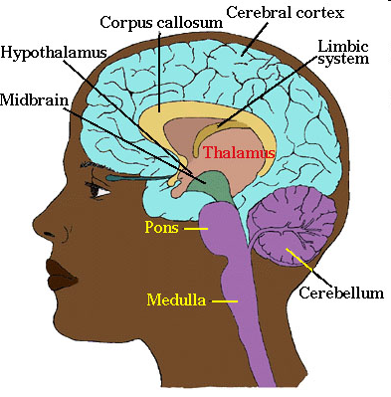
How we make sense of our world has deep “physiologic⬄behavioral” impact
Neuro-endocrine Outflow
Hormonal Regulation
Immune System
Somatic Organ Function
Autonomic Outflow
Blood Pressure
Heart Rate
Respiration
Neuro-peptide Outflow
Neurotransmitter Modulation
Endorphins, Oxytocin
Mood and Motivation

Slide 11
What is the state of current science?
Substantial research indicates that the arts and creative expression might be used:
To assist in recovery from trauma
Increase understanding of oneself and others
Develop a capacity for self-reflection
Reduce disease burden and symptoms
Alter behaviors and thinking patterns
Fosters a sense of connection to self and others

Slide 12



Turning now to loneliness: Three types!
Interpersonal • Psychological
“Does someone have my back?”
“Is there someone I can tell my troubles to?”
Societal • Organizational
“Am I welcome and valued?”
“Am I safe?”
Existential • Spiritual
“Does my life matter?”
“Am I disposable?”

Slide 13



Rituals
Routines
Boundaries

Slide 14
Dr. Sarah Ketchen Lipson is an assistant professor at the Boston University School of Public Health. Her research focuses on understanding and addressing mental health and disparities therein, particularly in college student populations. She is co-Principal Investigator of the national Healthy Minds Study, an annual survey of undergraduate and graduate student mental health, which has been conducted on hundreds of college and university campuses.
Dr. Doug Nemecek is the chief medical liaison for behavioral health integration, quality and clinical operations. He helps ensure network access and availability, patient safety, compliance with clinical guidelines, customer and provider satisfaction, and utilization management. Additionally, he works directly with customers and clients to mold operations and provides clinical expertise in new and existing behavioral health and integrated program development.
Mark Meridy has served as the Executive Director of DOROT since 2009. He has spent most of his career in the field of aging which has included serving as the Homecare Program Director at an Area Agency on Aging, developing Section 202 Senior Housing, and working on transportation and mobility issues for older adults. A leader in the field, he has recently appeared on MSNBC, CBS Morning News, and NPR’s “The Takeaway.”

Slide 15
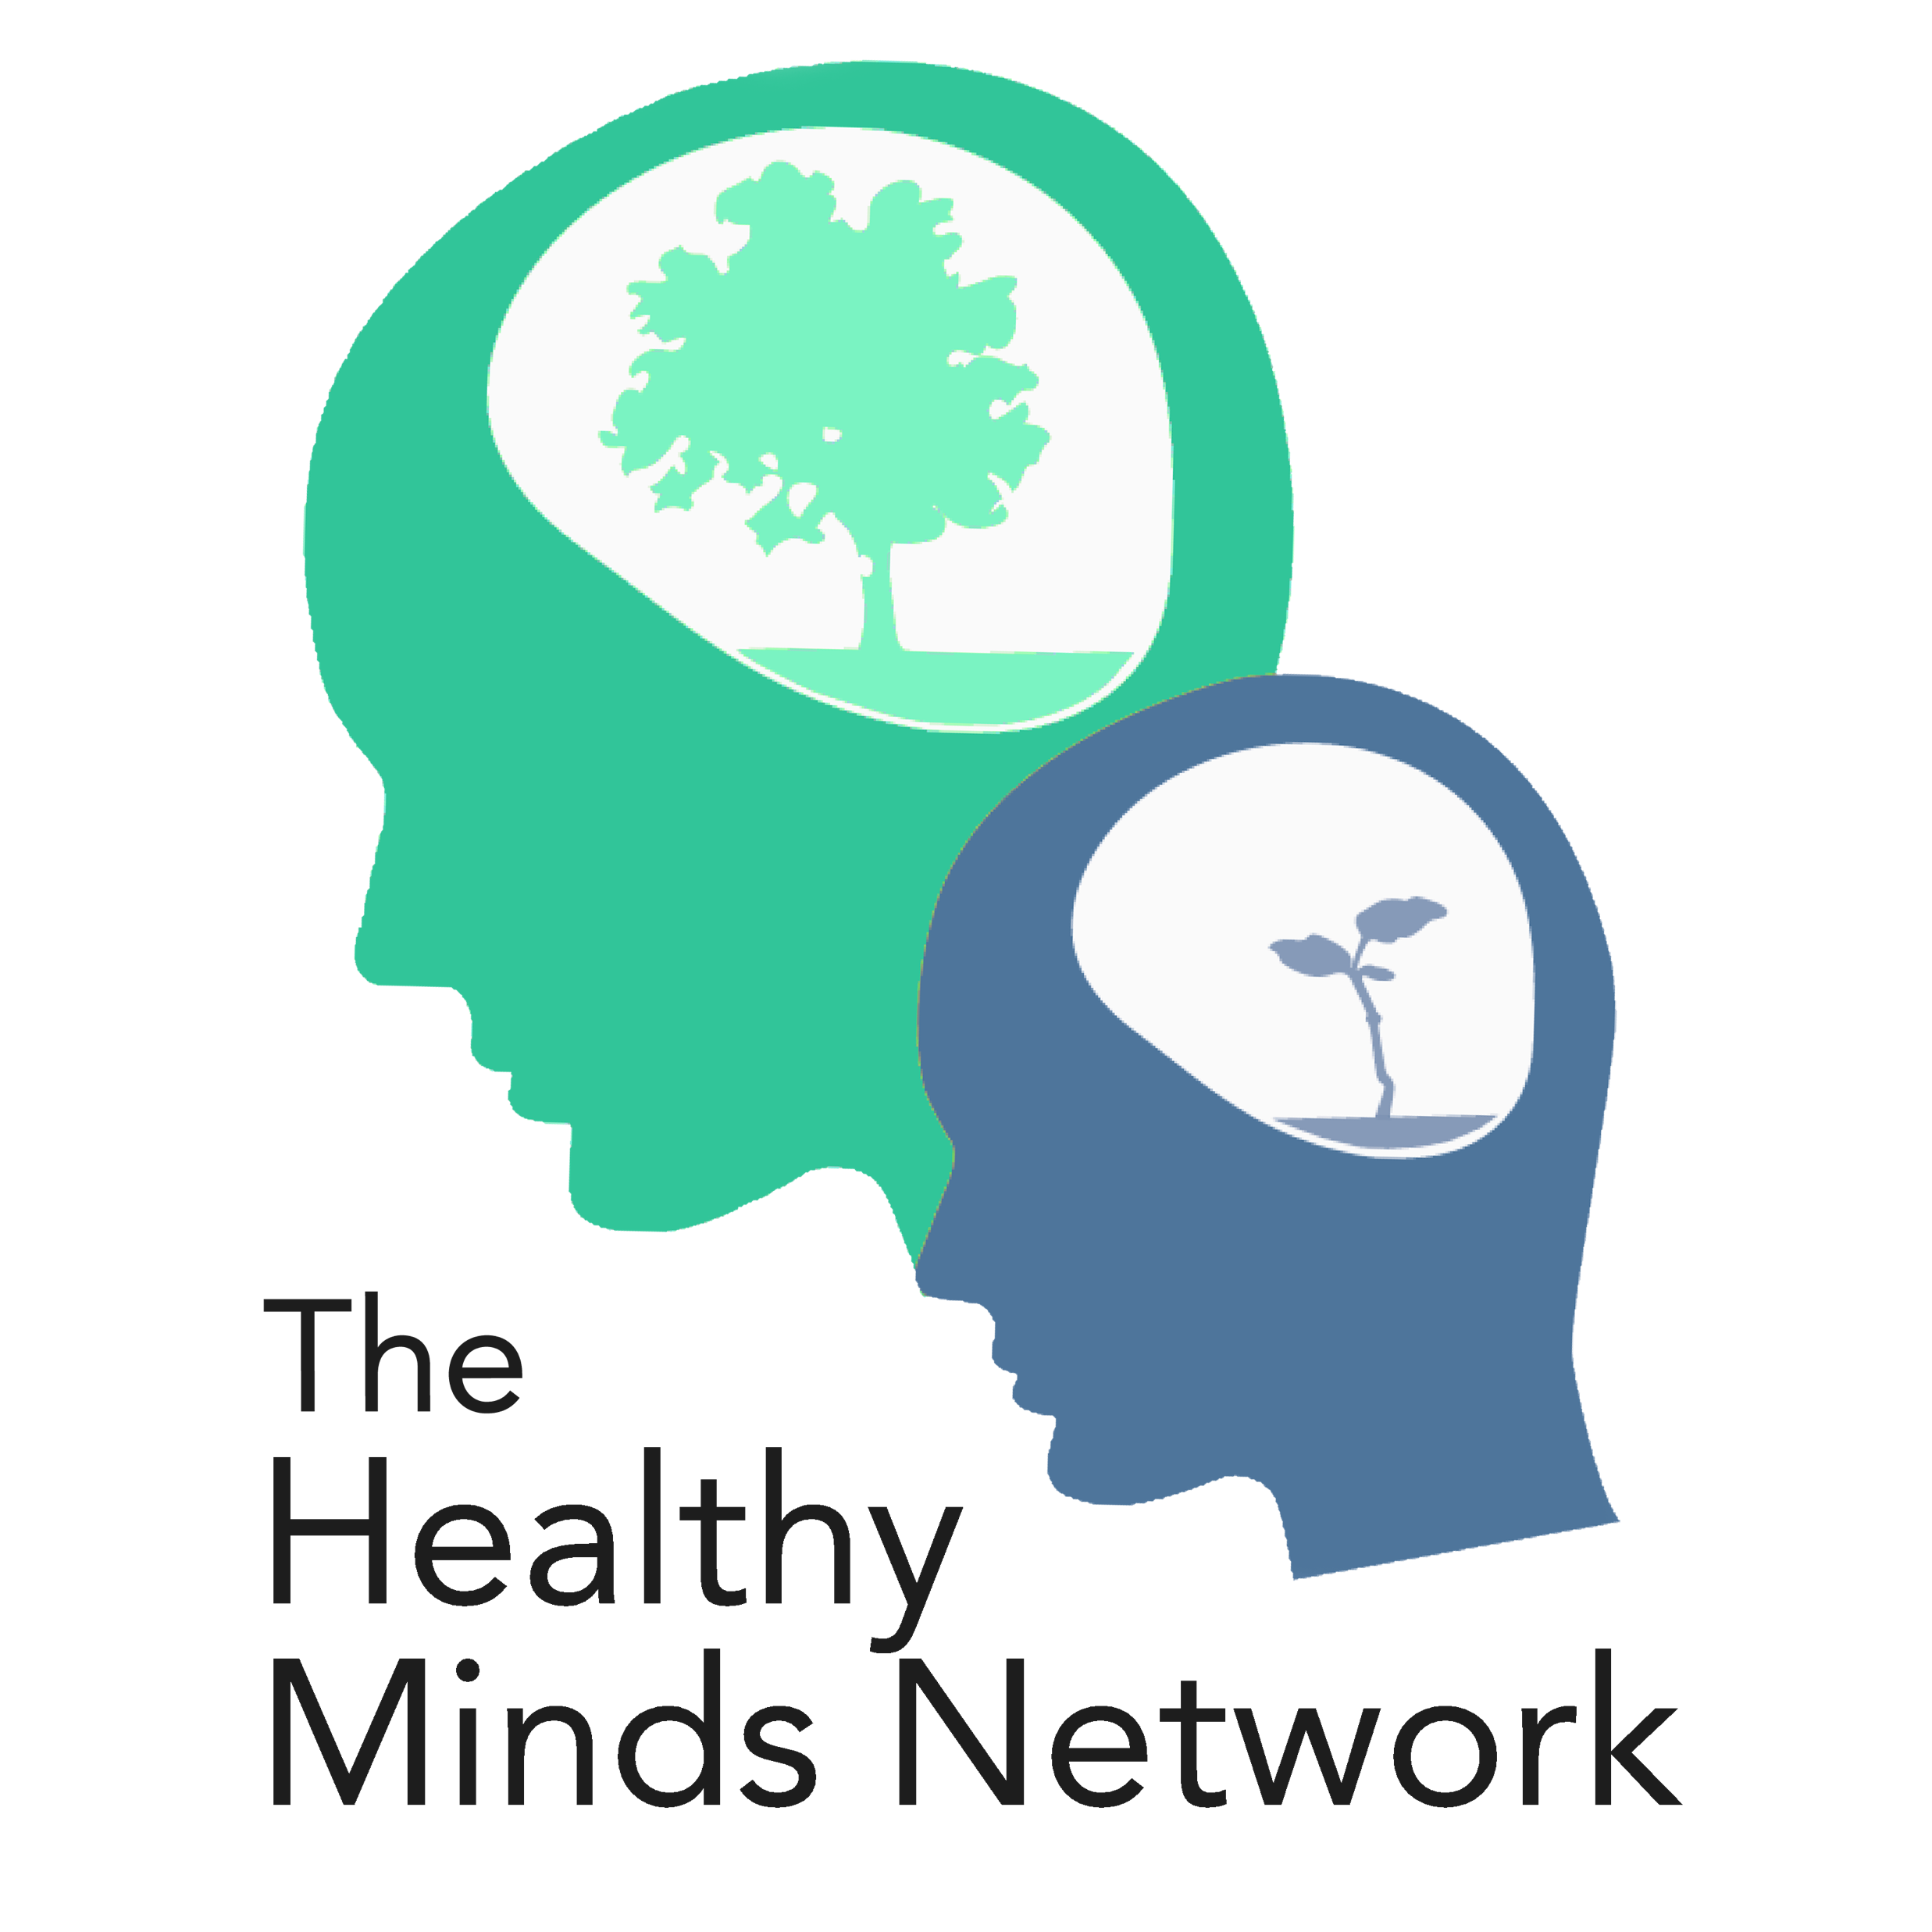
Mental Health in College Student Populations Evidence from the national Healthy Minds Study
Sarah Ketchen Lipson, PhD EdM (she/her/hers)
Assistant Professor, Boston University School of Public Health
Co-Principal Investigator, the Healthy Minds Study
The UnLonely Symposium 2021, mini keynote #1
Mental Health & COVID-19: Urgency and Opportunity

Slide 16
Significance of population
Age of onset
Treatment delay
Prevalence and burden of disease ($)
Campus settings offer unique opportunity for prevention and intervention
Public health impact: >22 million students
Significance from developmental perspective
Human resources
Mental health and lifelong trajectory (economic, educational, social)
Notes:
How this relates to other populations -- AYAs

Slide 17
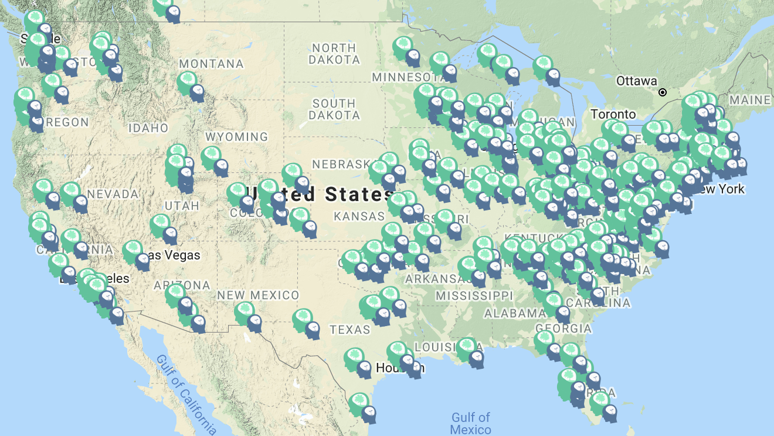
About the Healthy Minds Study
HMS team:
PIs: Sarah Lipson, Daniel Eisenberg, Justin Heinze
Peter Ceglarek, Paula Guro, Matt Jirsa, Afra Kamal, Divya Manikandan, Kevin Michaels, Jasmine Morigney, Akilah Patterson, Ellie Repp, Maithelee Sathe, Meghna Singh, Liadan Solomon, Amber Talaski, Caleb Wang, Adam Wheeler, Sasha Zhou
~400 campuses, >350,000 student respondents
Annual mental health survey
Cross-sectional
Qualtrics
Random student samples at each campus
Validated screening tools for mental health

Slide 18
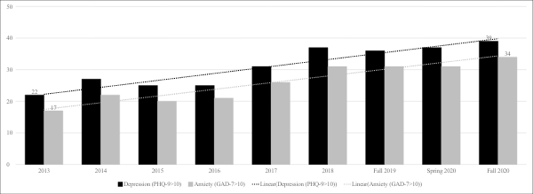

Rising prevalence of depression and anxiety symptoms, 2013-2020

Slide 19
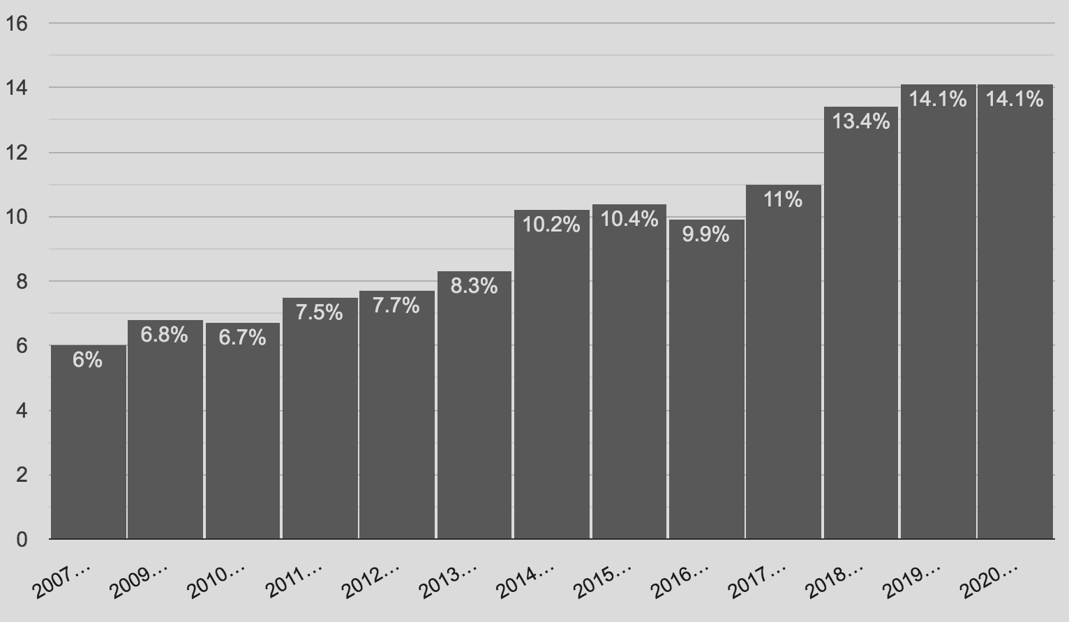
Suicidal ideation over time

Slide 20
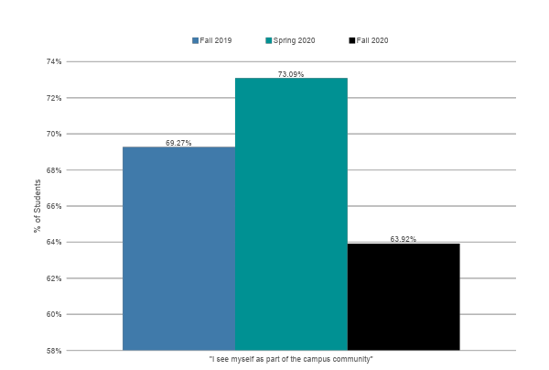
Sense of belonging

Slide 21
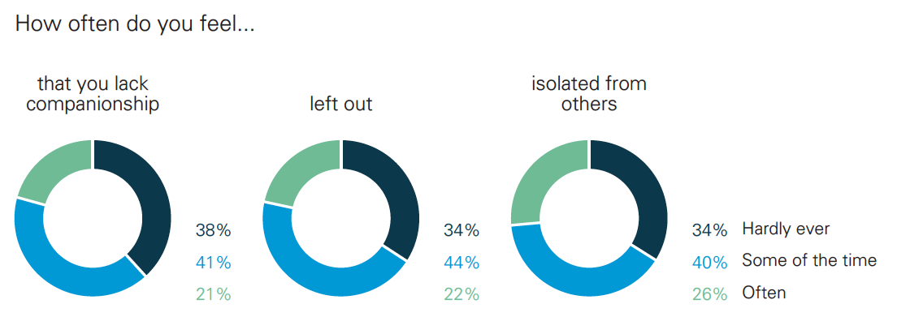
Loneliness, fall 2020

Slide 22
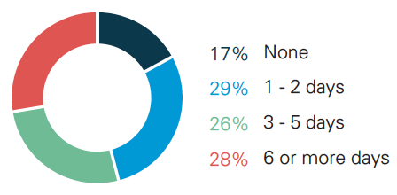
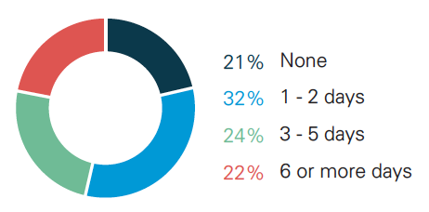
Academic impairment due to mental health concerns, past 4 weeks
Fall 2020
Fall 2019
83%
Reported at least 1 day of academic impairment due to MH
Increase
78%
Reported at least 1 day of academic impairment due to MH

Slide 23
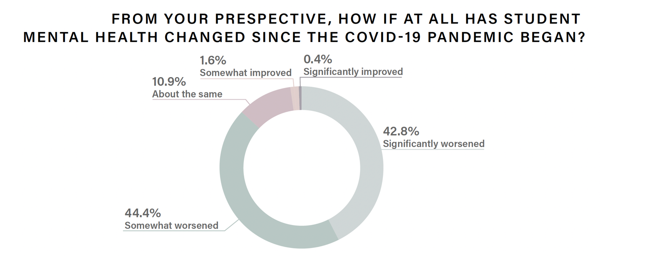
87% of faculty observe that student mental health has worsened in the pandemic
Notes:
Like reflects at least 2 things (actual worsening of student mental health and heightened awareness/exposure for faculty to see student mental health)

Slide 24
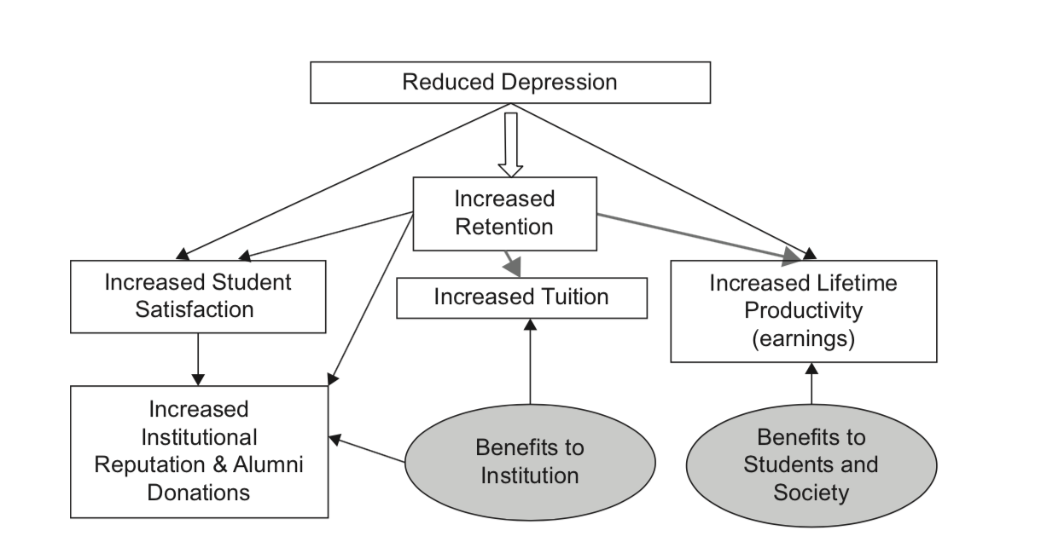
Economic case: strong return on investment for student mental health treatment & prevention
https://umich.qualtrics.com/jfe/form/SV_6xN9QUSlFtgtRQh

Slide 25

Thank you!
Sarah Ketchen Lipson, PhD EdM
sklipson@bu.edu
@DrSarahLipson
@healthymindsnet
www.healthymindsnetwork.org

Slide 26


Resilience for tomorrow
Our biggest test yet
2020 Cigna Resilience Index
950058 01/21

Slide 27
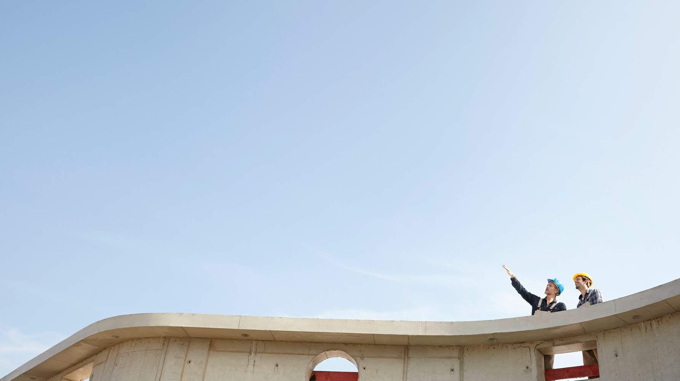
Resilience among full-time workers
2/3
4 in10
5x
6x
of full-time workers do not have high resilience
say they only sometimes feel they belong in their community, or don’t belong at all
less likely to feel they have opportunities to apply abilities in life
more likely to be unsatisfied with their current job
Source: Cigna Resilience Index: 2020 U.S. Report.
Confidential, unpublished property of Cigna. Use and distribution limited solely to authorized personnel. © 2021 Cigna

Slide 28
A positive workplace culture benefits workers’ resilience
INCLUSIVITY AND AUTHENTICITY
40% of full-time workers who do not feel the need to hide their true selves at work are considered to have high resilience, compared with 32% of those who do
COMPANY CONTRIBUTION
Full-time workers who agree that their company contributes to the greater good are significantly more likely to be resilient than those who disagree (41% vs. 18%)
COMMUNITY
Full-time workers who feel included in the social aspects of work are more likely to have high resilience (42% resilient vs. 18% resilient)
Source: Cigna Resilience Index: 2020 U.S. Report.
Confidential, unpublished property of Cigna. Use and distribution limited solely to authorized personnel. © 2021 Cigna

Slide 29







Supporting employees as they face challenges
SOCIAL CONNECTIVITY AT WORK
INCLUSIVE AND DIVERSE WORKPLACE
TRANSPARENT TWO-WAY COMMUNICATION
ACCESS TO RESOURCES AND TOOLS
HOLISTIC HEALTH
TECHNOLOGY
Focus on mental and physical health and a good work-life balance
Improve the quantity and quality of communications and relationships with coworkers and peers
Create diverse racial, cultural, ethnic and social backgrounds to improve workplace morale and strengthen resilience
Facilitate proactive conversations between employees, managers and leadership
Help find the right balance between overuse and under use of digital communication tools (chat, phone, video, etc.)
Offer Employee Resource Groups, paid parental leave, mental health resources and more
Source: Cigna Resilience Index: 2020 U.S. Report.
Confidential, unpublished property of Cigna. Use and distribution limited solely to authorized personnel. © 2021 Cigna

Slide 30
Isolation and Older Adults – Made Worse By COVID
Mark L. Meridy
Executive Director

Slide 31
DOROT’s Vision & Mission
Vision
DOROT will be an innovative leader in mobilizing volunteers of all ages to improve the lives and health of older adults, addressing the challenges of an aging society.
Mission
DOROT alleviates social isolation among older adults and provides services to help them live independently as valued members of the community. We serve the Jewish and wider community, bringing the generations together in a mutually beneficial partnership of elders, volunteers and professionals. Our work provides an effective model for others.

Slide 32
DOROT By The Numbers
Founded 45 years ago in 1976
Engaged over 5,507 Older Adults
Participated in over 84,410 programs
Average age of a DOROT client is 82 with 64% of them living alone.
Engaged over 6,000 Volunteers
Pre-COVID primary focus was NYC and Westchester County
Now a virtual platform and engage older adults from 20 states and volunteers from 39 states.

Slide 33
Challenges of an Aging Society
Every day in the US, 10,000 people turn 65; will represent over 20% of the population by 2050.
More older adults are living alone and farther from family supports
43% of adults 60+ report feeling lonely
Retirement at 65 or 70 - often live for 20+ more years
Lack of a sense of purpose and usefulness
Of those 65+, the 85+ is the fastest growing cohort - increasingly need services at home or in the community to maintain their independence.
All contribute to increasing risk
of social isolation

Slide 34
COVID and Older Adults Deadly Consequences
Majority of COVID cases were in those under the age of 50
However, 80% of the deaths from COVID were those 65+
For many older adults COVID resulted in increased loneliness and social isolation
Decline in overall health
Mental acuity impacted by not engaging with the outside world
Increase levels of depression

Slide 35
We Know that meaningful
social engagement is critical.
DOROT provides a range programs to improve the quality of life, independence, and social connectedness of older adults

Slide 36
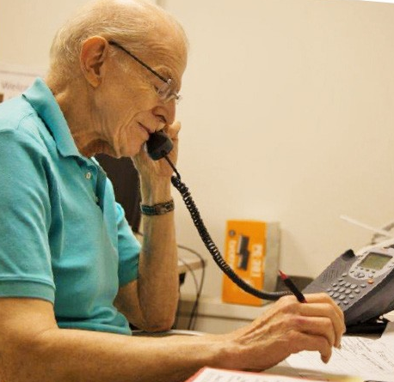
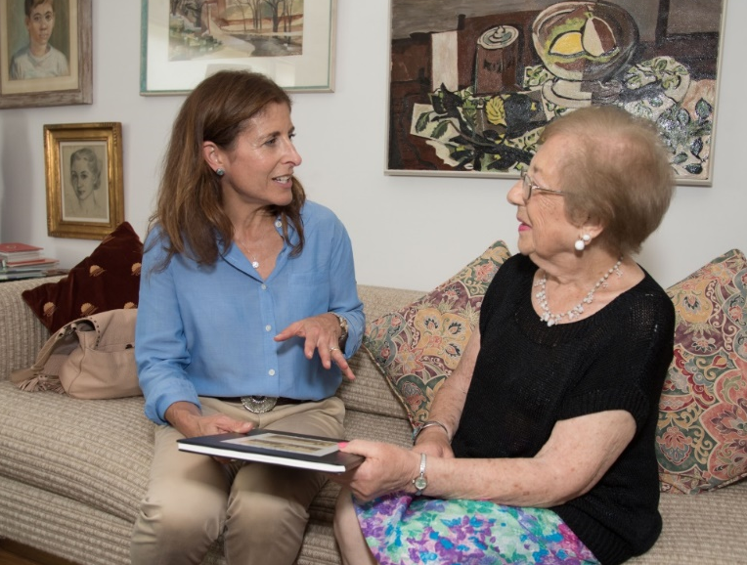
Building Social Connections Through Vibrant Programming with Peers and Volunteers
Support over 500 Friendly Visiting Matches – Now Virtually
Onsite Programming became Onsite@Home – COVID Response
Caring Calls – (700 telephone matches) COVID Response
University Without Walls – Expanded during COVID

Slide 37
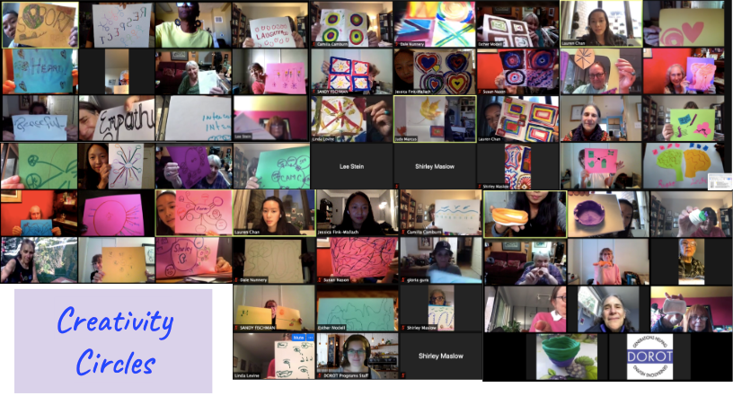
Successful Partnership with
The UnLonely Project
Aging Creativity Circles & DOROT
Back to Basics
Emphasizes Shared Experiences
Builds Community
Noteworthy Positive Results!
Tool for connection across community organizations
Educational tool
Notes:
Successful Aging Creativity Circles + DOROT - Bold is for slide, nonbold is for narrative (not included on slide)
Back to Basics: The curriculum is simple and includes straightforward activities that provide simple satisfaction and quick pay-off. The activities made it easy to engage in arts and discussion. Friendly for all comfort levels.
Emphasizes Shared Experiences: Curriculum gives older adults insight into how similar to shared struggles, gives common ground and opportunity to see how other people deal with similar situations in different ways
Builds Community: Appreciate, enjoy progression of community we built over 8 weeks. Noticeable different between participation at beginning, participation now. An ease to which participants show up and respond to the prompts and each other.
Noteworthy Positive Results! Results from the Foundation for Arts & Healing showed confidence around managing aging, better able to modulate emotions, improved quality of life, increase sense of meaning in life, greater resilience
Additional points, if want to include:
Tool for connection across community organizations: Online platform; easy to navigate. Resources have been available to us, actively work to make sure we can connect with other facilitators in online forum and zoom calls.
Educational tool: Benefits for student facilitators to have this experience. New to facilitating, our group leaders felt more prepared to manage time in a group setting. Participants are comfortable sharing in between sessions, openness between participants and facilitator

Slide 38



Appreciating the Impact of Human Connection

Slide 39
Thank You
www.dorotusa.org

Slide 40
Let’s go to the movies!

Slide 41
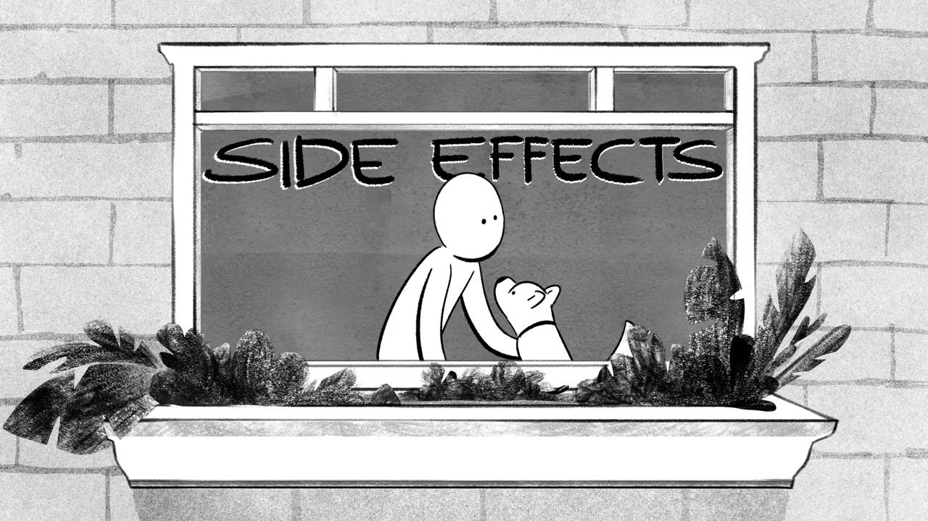

Slide 42
Hope you enjoyed the film!
We use films like this in our programs to promote conversation and personal sharing of life experience

Slide 43
Trailer for UFF#5

Slide 44
Breakout Room Facilitators
Campus: Chris Chamberlin, Dean of Students at Cooper Union
Workplace A: Marco Diaz, Global Head of Benefits at Newcorps
Workplace B: Pamela Corson PhD, LPC, CADC, CEAP, Vice President, Health & Wellness, Prudential
Aging Communities: Jason Molony, SHARE Network, Project Manager
Community: Diane Dickerson, CEO of the Bangor, Maine regional YMCA

Slide 45
Facilitator perspective: A quick round-robin
Any intriguing current mental health interventions?
Any promising possibilities?
Final 30 second comments by keynoters
What to keep your eye on going forward

Slide 46
Upcoming Events
June 6th @ 8pm ET The UnLonely Film Festival 5 Awards Event

Slide 47
Thank You!
We’ll be in touch...

